Slide 1

The Use of Utility Theory in Artificial Intelligence
Math 301 – Game Theory
Vraj Patel
Dhruv Patel

Slide 2



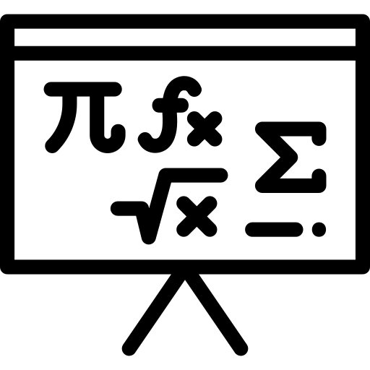




Table of Content
4
2
3
1
Practical Implementation
Mathematical Framework
Utility Theory in AI Applications
Introduction to Utility Theory

Slide 3
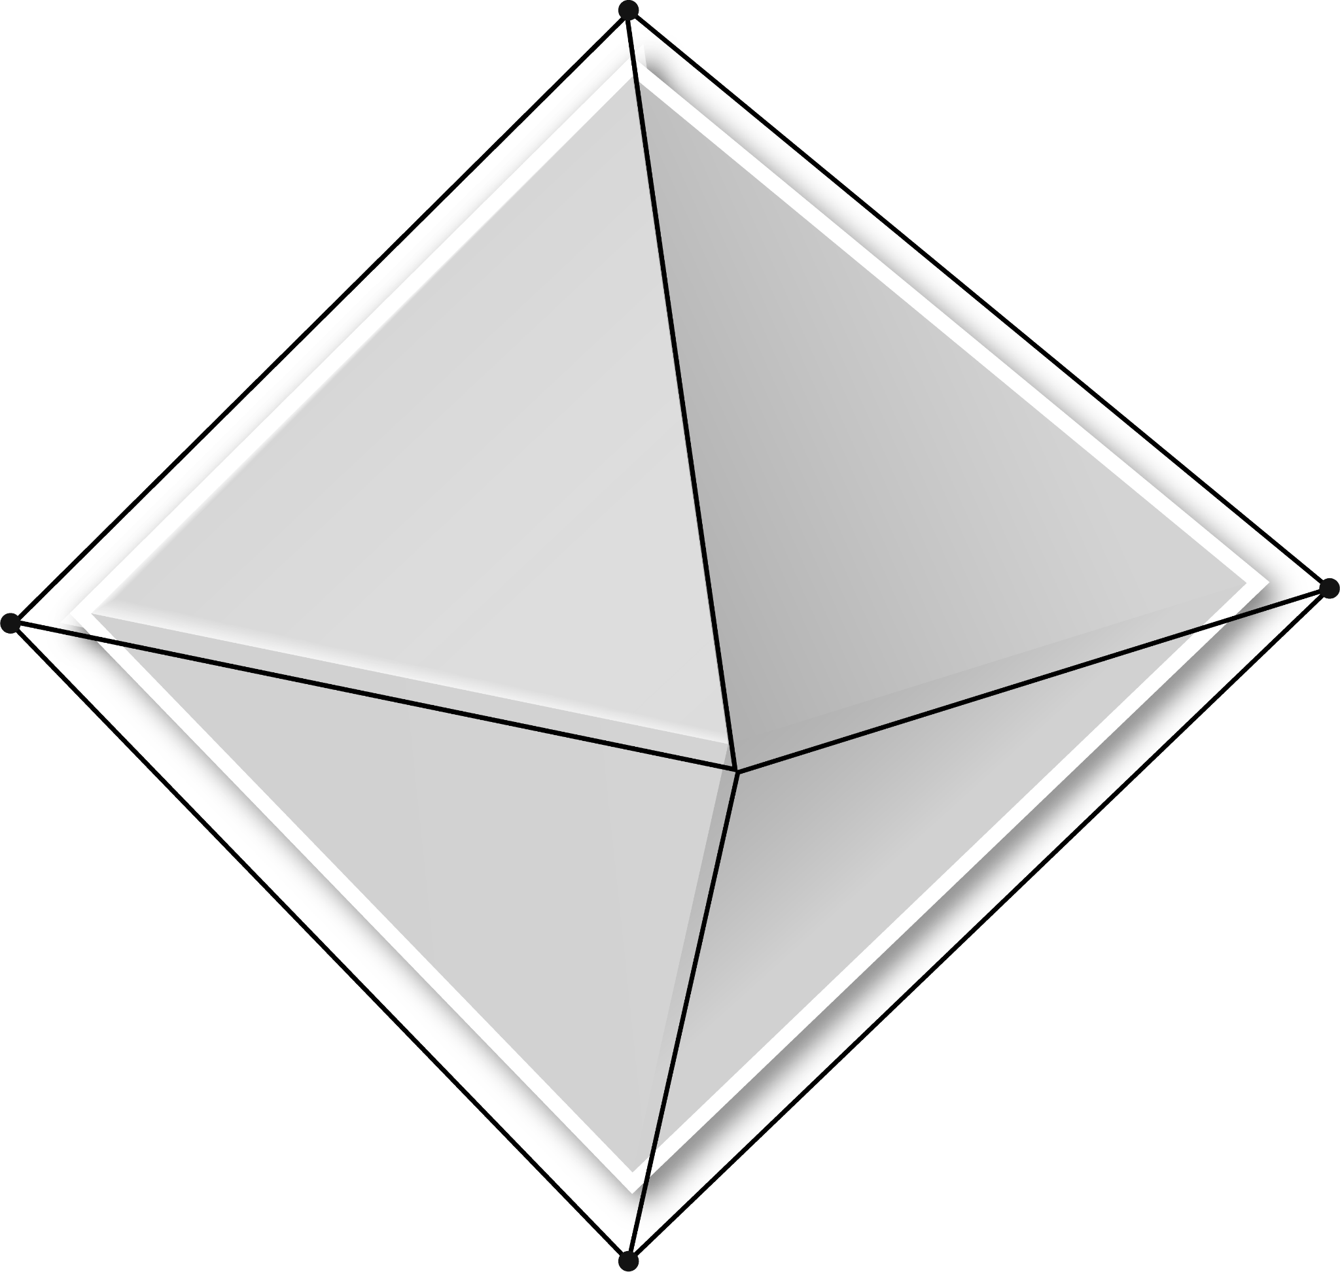
01
Introduction to Utility Theory

Slide 4
What is Utility Theory?
Utility Theory in AI is a framework that is used to model decision making under uncertainty.
We rank our choices depending on:
Our needs
Preferences
An agent has a specific goal that it needs to maximize, known as the utility.

Slide 5
What is a Utility Function?
A utility function for a given player assigns a number of every possible outcomes with the probability that a higher number suggests the outcome that is preferred.
In AI, an agent has preferences captured where a single number is assigned to express the desired outcome of a state.
If there is a level of uncertainty in the preferences made by the agent, the utility is known as the expected value.
When a rational agent chooses a method that gives the maximum outcome based on the agent’s expected utility, it is known as MEU.

Slide 6
Example of Lottery
Suppose we have two choices:
$1000
50% chance of $3000
Which option would we choose?
Let’s say we assign 0 to winning nothing, 100 to winning $3000, and 80 to $1000.
The difference between what we have now and $1000 is four times greater than the difference between $1000 and $3000.
For option A, 80% utilities is guaranteed. For option B, it 50% chance of the 100 utilities.
Our decision would be based on risk, finance and a personal preference. This is the same way an agent uses to base its options mathematically using utility theory.
A lottery L with possible outcomes S₁, … S_{n}. with probabilities p₁, … p_{n} is represented as L = [p₁, S₁; p₂, S₂; …. ; p_{n}, S_{n}]

Slide 7
02
Mathematical Framework

Slide 8
Von Neumann-Morgenstern Utility Theorem
The VNM theorem states that decision-makers choosing between risky options will behave as if they are maximizing an underlying utility function, and there are four conditions that must be met for this to be valid. These conditions include:
i) Completeness: For all outcomes, A & B players have preferences i.e., U_{i}(A) > U_{i}(B), U_{i}(A) = U_{i}(B), or U_{i}(A) < U_{i}(B)
ii) Transitivity: If U_{i}(A) > U_{i}(B) and U_{i}(B) > U_{i}(C), then U_{i}(A) > U_{i}(C)
iii) Continuity: For all A, B, C, preferred in that order, there must be a probability p (between 0 and 1) such that U_{i}(B) = p * U_{i}(A) + (1-p)*U_{i}(C)
iv) Independence (of Irrelevant Alternatives): Preferences over lotteries must remain consistent regardless of the choices.If one is indifferent over A or 50% Chance of B, and indifferent between B and C, then the player should be indifferent over lottery of A or 50% chance of C.

Slide 9
03
Utility Theory In AI Applications

Slide 10
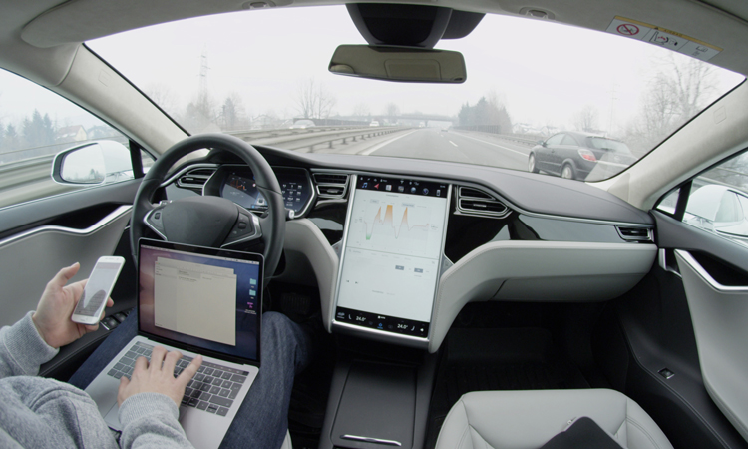
Self-Driving Cars: Navigating the Road with Utility-Driven Decisions
Self-driving cars utilize utility functions to evaluate the potential consequences of various actions, such as changing lanes, overtaking, or maintaining a steady speed.
These utility functions carefully consider factors such as the risk of collisions, the time it takes to reach the destination, and the comfort of passengers.
By maximizing the expected utility, self-driving cars can navigate roads safely and efficiently, reducing accidents and improving traffic flow.

Slide 11
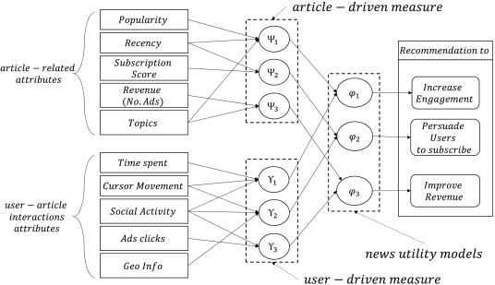
Recommendation Systems: Personalized Suggestions Guided by Utility
Recommendation systems employ utility functions to quantify the desirability of different items for each user.
These utility functions consider factors such as the user's past purchases, ratings, and browsing history, as well as the popularity of the items and their relevance to the user's current interests.
By maximizing the expected utility, recommendation systems can provide personalized suggestions that are likely to appeal to each user's unique tastes and preferences.

Slide 12
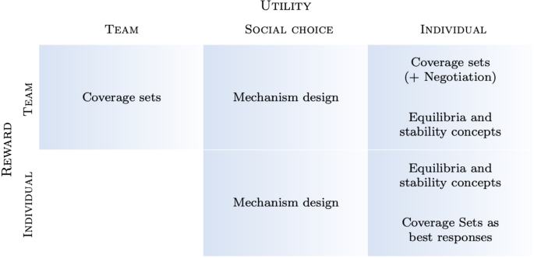
Reinforcement Learning: Learning Optimal Strategies through Utility Maximization
Reinforcement learning algorithms use utility functions to guide the agent's interactions with its environment.
The agent receives rewards or penalties for its actions, and over time, it learns to select actions that maximize its expected cumulative reward. For instance, a reinforcement learning algorithm might be used to train a robotic arm to perform a complex task, such as assembling a product.
The agent would learn to manipulate the arm's movements to achieve the desired outcome, guided by the utility function that represents the successful completion of the task.

Slide 13
04
Practical Implementation

Slide 14
Best route Algorithm
In this example, we provide a simple code written in Python specifically for choosing the best route amongst several options.
It incorporates different utility functions (linear and logarithmic) to evaluate the desirability of routes based on factors like:
Road quality
Distance
We first calculate the expected utility under varying traffic conditions and visually compare the utilities.

Slide 15
Functions
We use five various functions in our program to calculate the best route from utility functions:
utility_function_linear(distance, road_quality)
utility_function_logarithmic(distance, road_quality)
calculate_expected_utility(route, utility_function)
choose_best_route(routes, utility_function)
plot_utilities(routes, utility_functions)

Slide 16
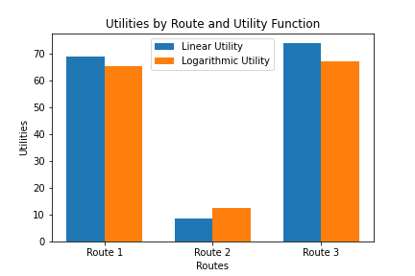
Linear vs Logarithmic

Slide 17
How Linear vs Log Functions vary?
In a linear utility model, changes in input (like distance or road quality) have a constant effect on utility.
In a logarithmic model, the utility decreases more rapidly for initial increases in distance and then levels off.
The choice between these two depends on how the decision-maker values changes in the attributes.
The linear utility function implies a consistent valuation of changes, while the logarithmic function implies a diminishing sensitivity to changes as values increase.

Slide 18
Questions

Slide 19
Thank you!

Slide 20
References
Calculemus. (n.d.). Expected value, expected utility and multi-attribute utility theory. https://www.calculemus.org/lect/L-I-MNS/06/exp-ut1.html#:~:text=The%20solution%3A%20Expected%20utility%20theory,quantify%20the%20amount%20of
Dazeley, R., Vamplew, P., Foale, C., Young, C., Aryal, S., & Cruz, F. (2021). Levels of explainable artificial intelligence for human-aligned conversational explanations. Artificial Intelligence, 299, 103525. https://doi.org/10.1016/j.artint.2021.103525
Eintalu, J. (2019, December 9). Some simple utility functions. Medium. https://eintalu.medium.com/some-simple-utility-functions-cc04c545ce02
Martins, T. G. (2014, January 22). Declining marginal utility and the logarithmic utility function. Wordpress. https://tgmstat.wordpress.com/2014/01/22/declining-marginal-utility-and-the-logarithmic-utility-function/#:~:text=,notion%20of%20declining%20marginal%20utility
Russell, S., & Norvig, P. (2021). Artificial intelligence: A modern approach. Pearson Higher Ed.
StudySmarter. (2023). Utility functions. https://www.studysmarter.co.uk/explanations/microeconomics/consumer-choice/utility-functions/
Tansuchat, R., & Kosheleva, O. (2022). How to make recommendation systems fair: An adequate utility-based approach. Asian Journal of Economics and Banking, 6(3), 308-313. https://www.emerald.com/insight/content/doi/10.1108/AJEB-03-2022-0031/full/pdf
Von Neumann, J., & Morgenstern, O. (2007). Theory of games and economic behavior (60th Anniversary Commemorative Edition). Princeton university press.
Yang, Q., & Liu, R. (2023). Understanding the application of utility theory in robotics and artificial. https://arxiv.org/pdf/2306.09445.pdf

